Slide 1
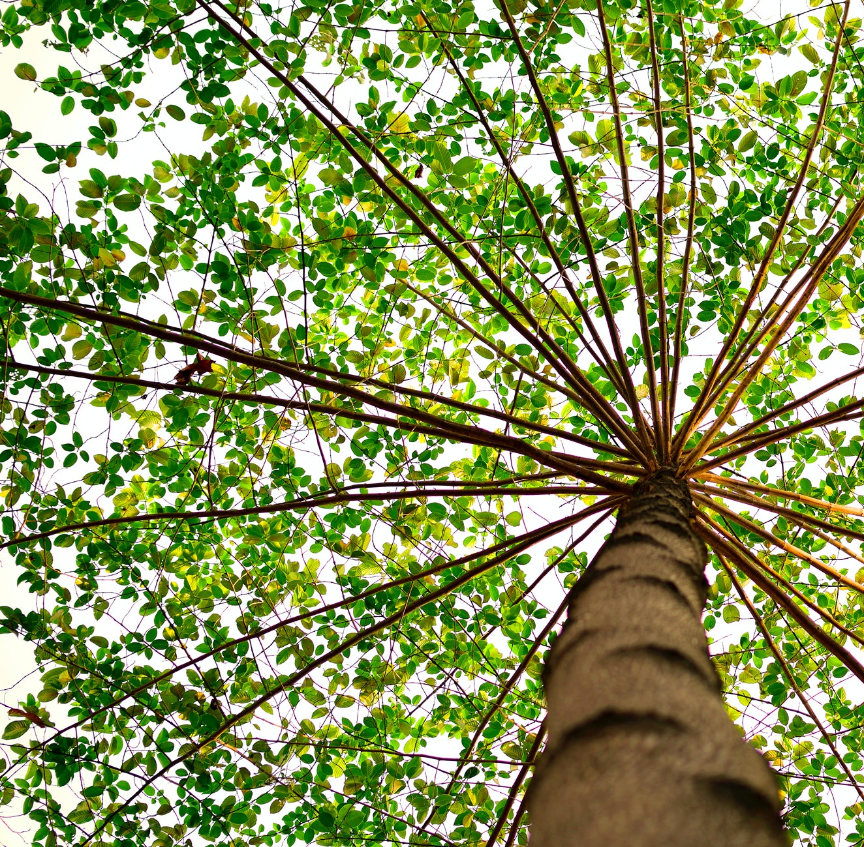
Growth through community
Georgia Aitkenhead
Pronouns: she/her
gaitkenhead@turing.ac.uk
Notes:
Growth through community – community involvement – better science, more relevant to the lives of autistic people and their families, and the research process itself more empowering,

Slide 2






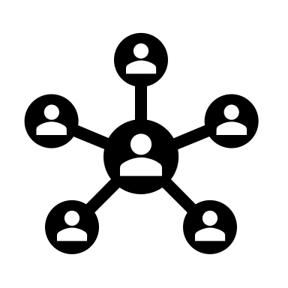
Design
Legal Advice
Strategy
Co-authorship
Code
Ideas
Networks
Notes:
We are a core research team of 2 - myself and Kirstie - one of our main sources for this – focus group sessions –

Slide 3
Overview
Focus groups
Example insights
Translation to code
Future work: Moderation

Slide 4
Overview
Focus groups
Example insights
Translation to code
Future work: Moderation

Slide 5
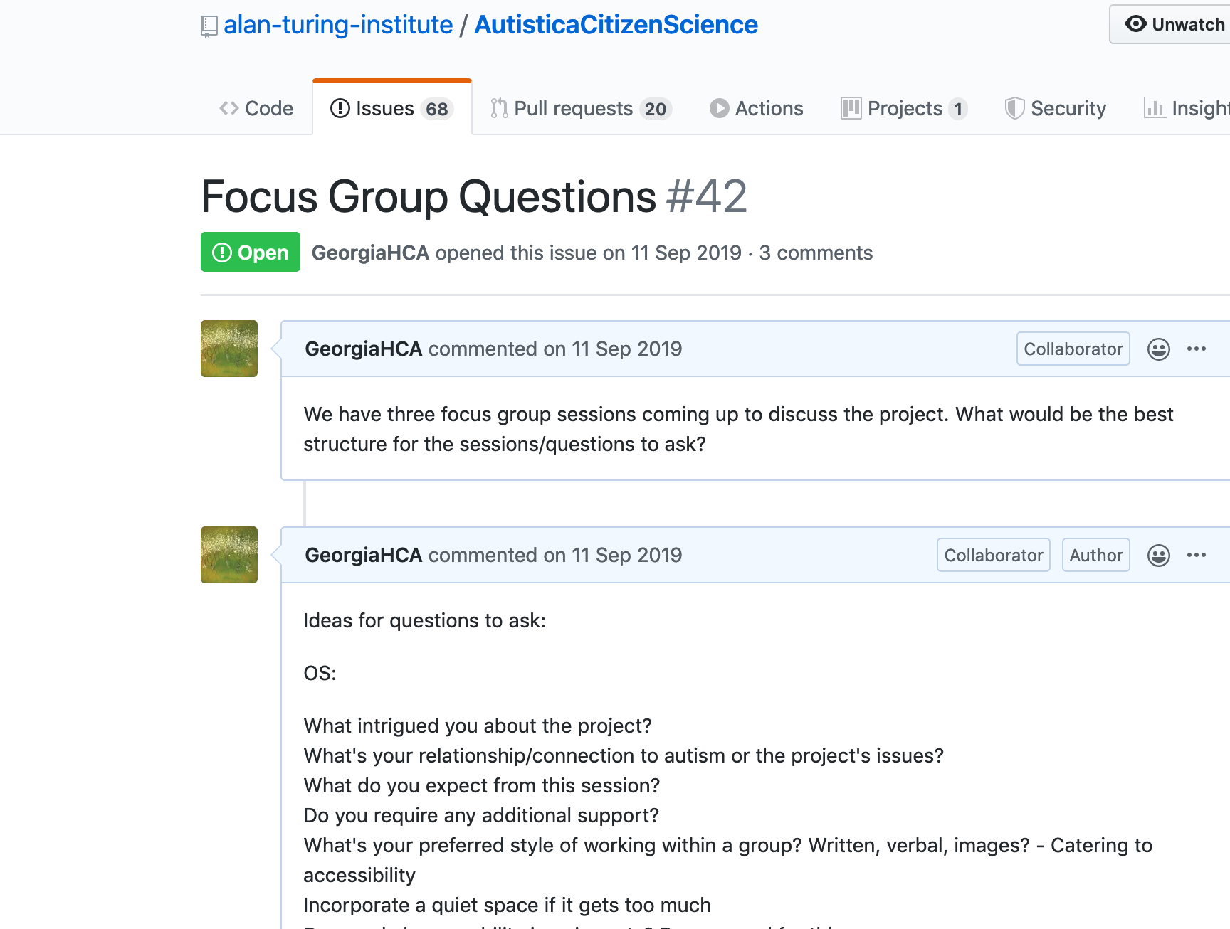
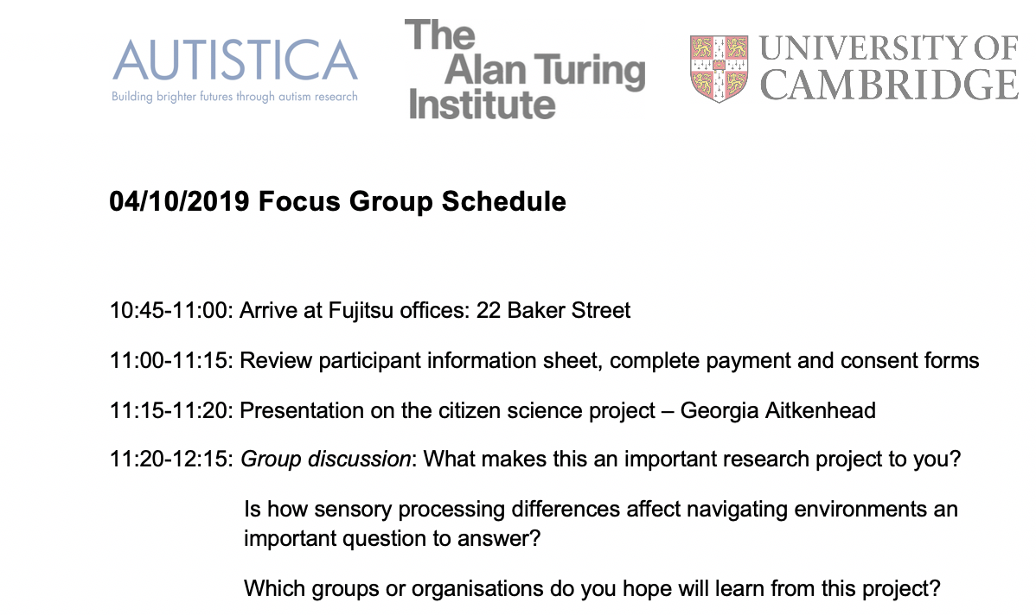
+
Focus group sessions
Autistica
3
5.5
18
The Alan
Turing
Institute
Fujitsu
Notes:
SCOPING WORK – just the tip of the iceberg. – as Kirstie already spoke - building from scoping sessions - 2 focus groups – 26 participants, much more general discussions – narrow in on what are the priorities emerging from the community.
THANKS OTIS - brainstorming and reviewing the agenda

Slide 6
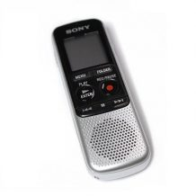
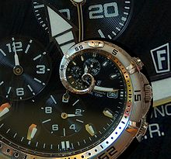


Focus group sessions
Transcripts
This Photo by Unknown Author is licensed under CC BY-SA
This Photo by Unknown Author is licensed under CC BY-SA
>15 hours
>150 pages
Notes:
This took a long time – there were over 15 hours of recording to note down verbatim – 15 hours of recording takes a LOT longer than 15 hours to transcribe: pause, ascertain, self-correct, sound adjustment; this is more complex the more people there are – as have to match voices to label them correctly – information depersonalized (not always obvious the extent to which to do this – broader categories)
When you’re transcribing multiple people talking really important to capture it with fidelity – huge responsibility (this Is better done by the person in the room than AI)

Slide 7
Focus group sessions
Transcripts
Summaries
INSERT. THEMES
Notes:
key co-designed with Otis Smith/using feedback from previous participants – what do we need to include?
KEY – emerge from the discussions – across discussions – useful to the design of the platform –
MANY HATS- autism researchers, parents, autistic themselves, developers who were also parents of autistic people or who had autistic people in their families, teachers who were also autistic, disability experts who were parents of autistic people and autistic themselves.
Bullet points rather than picture – separate point – duplicate slide – right hand side in first one – themes – slide six – key
Thematic analysis - research – categories then key

Slide 8
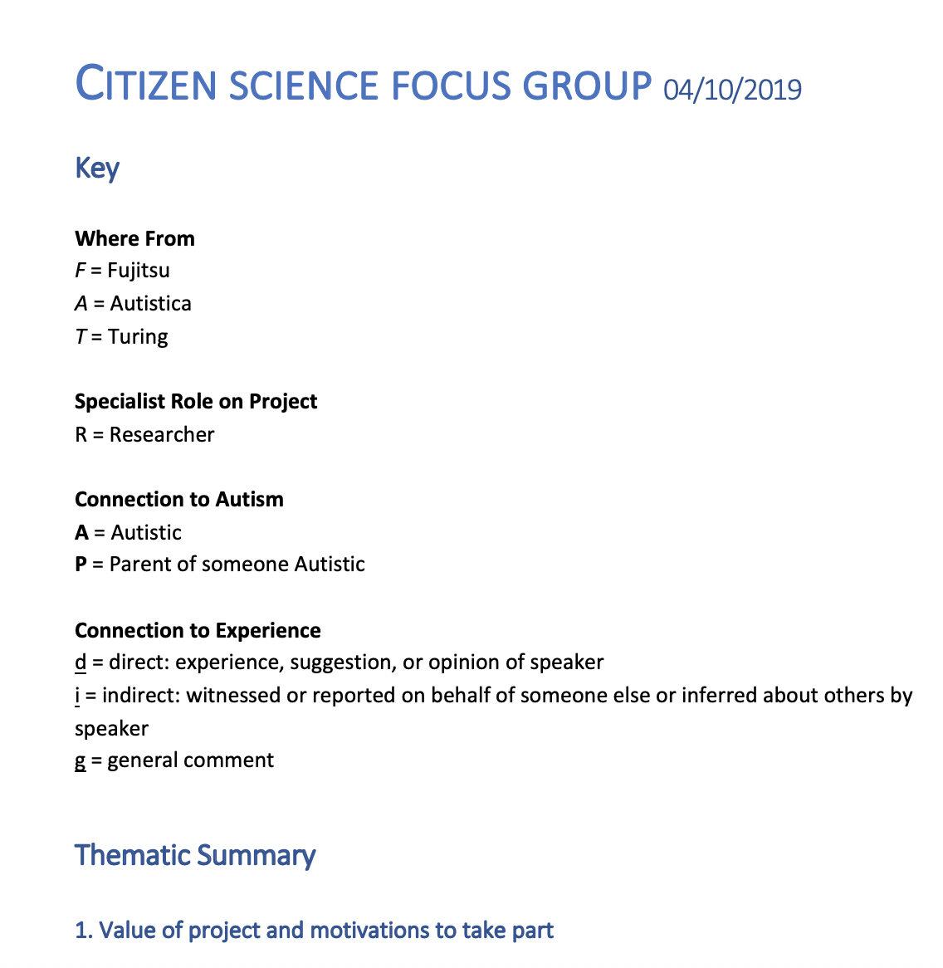
Focus group sessions
Transcripts
Summaries
Notes:
Summaries: THANKS OTIS
key co-designed with Otis Smith/using feedback from previous participants – what do we need to include?
KEY – emerge from the discussions – across discussions – useful to the design of the platform –
MANY HATS- autism researchers, parents, autistic themselves, developers who were also parents of autistic people or who had autistic people in their families, teachers who were also autistic, disability experts who were parents of autistic people and autistic themselves.
Bullet points rather than picture – separate point – duplicate slide – right hand side in first one – themes – slide six – key
Thematic analysis - research – categories then key

Slide 9

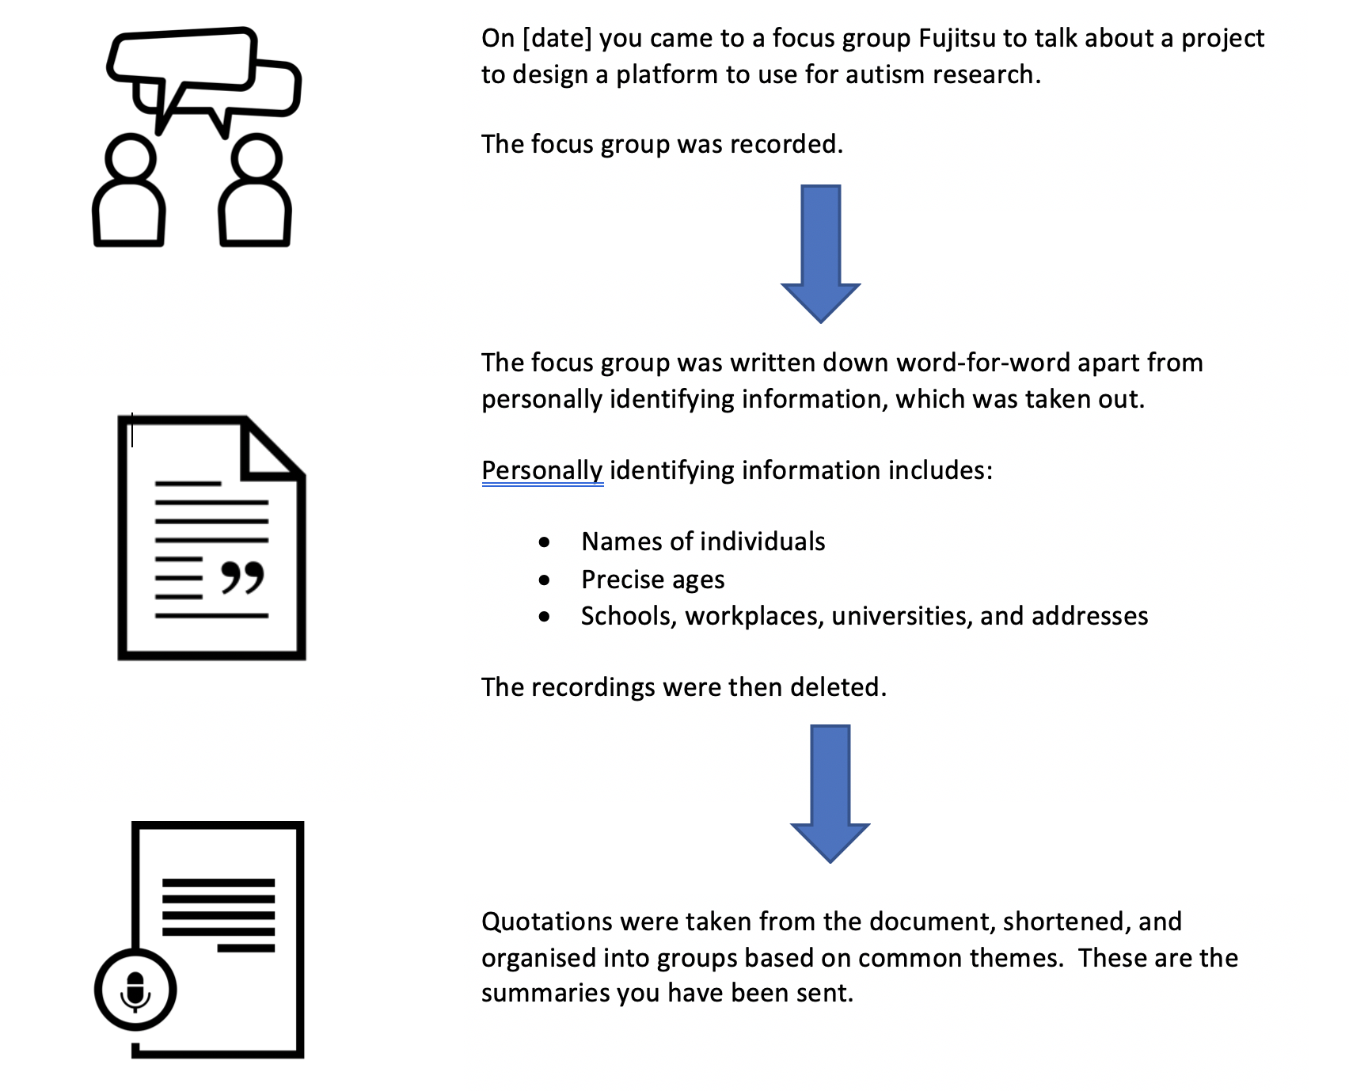
Focus group sessions
Transcripts
Summaries
Review
This Photo by Unknown Author is licensed under CC BY-NC-ND
Notes:
Sent out to community – nothing compromising, reflects views – more on how to make them accessible, types of reformatting etc.
Guidelines – iterations – thank you James. Scott!

Slide 10
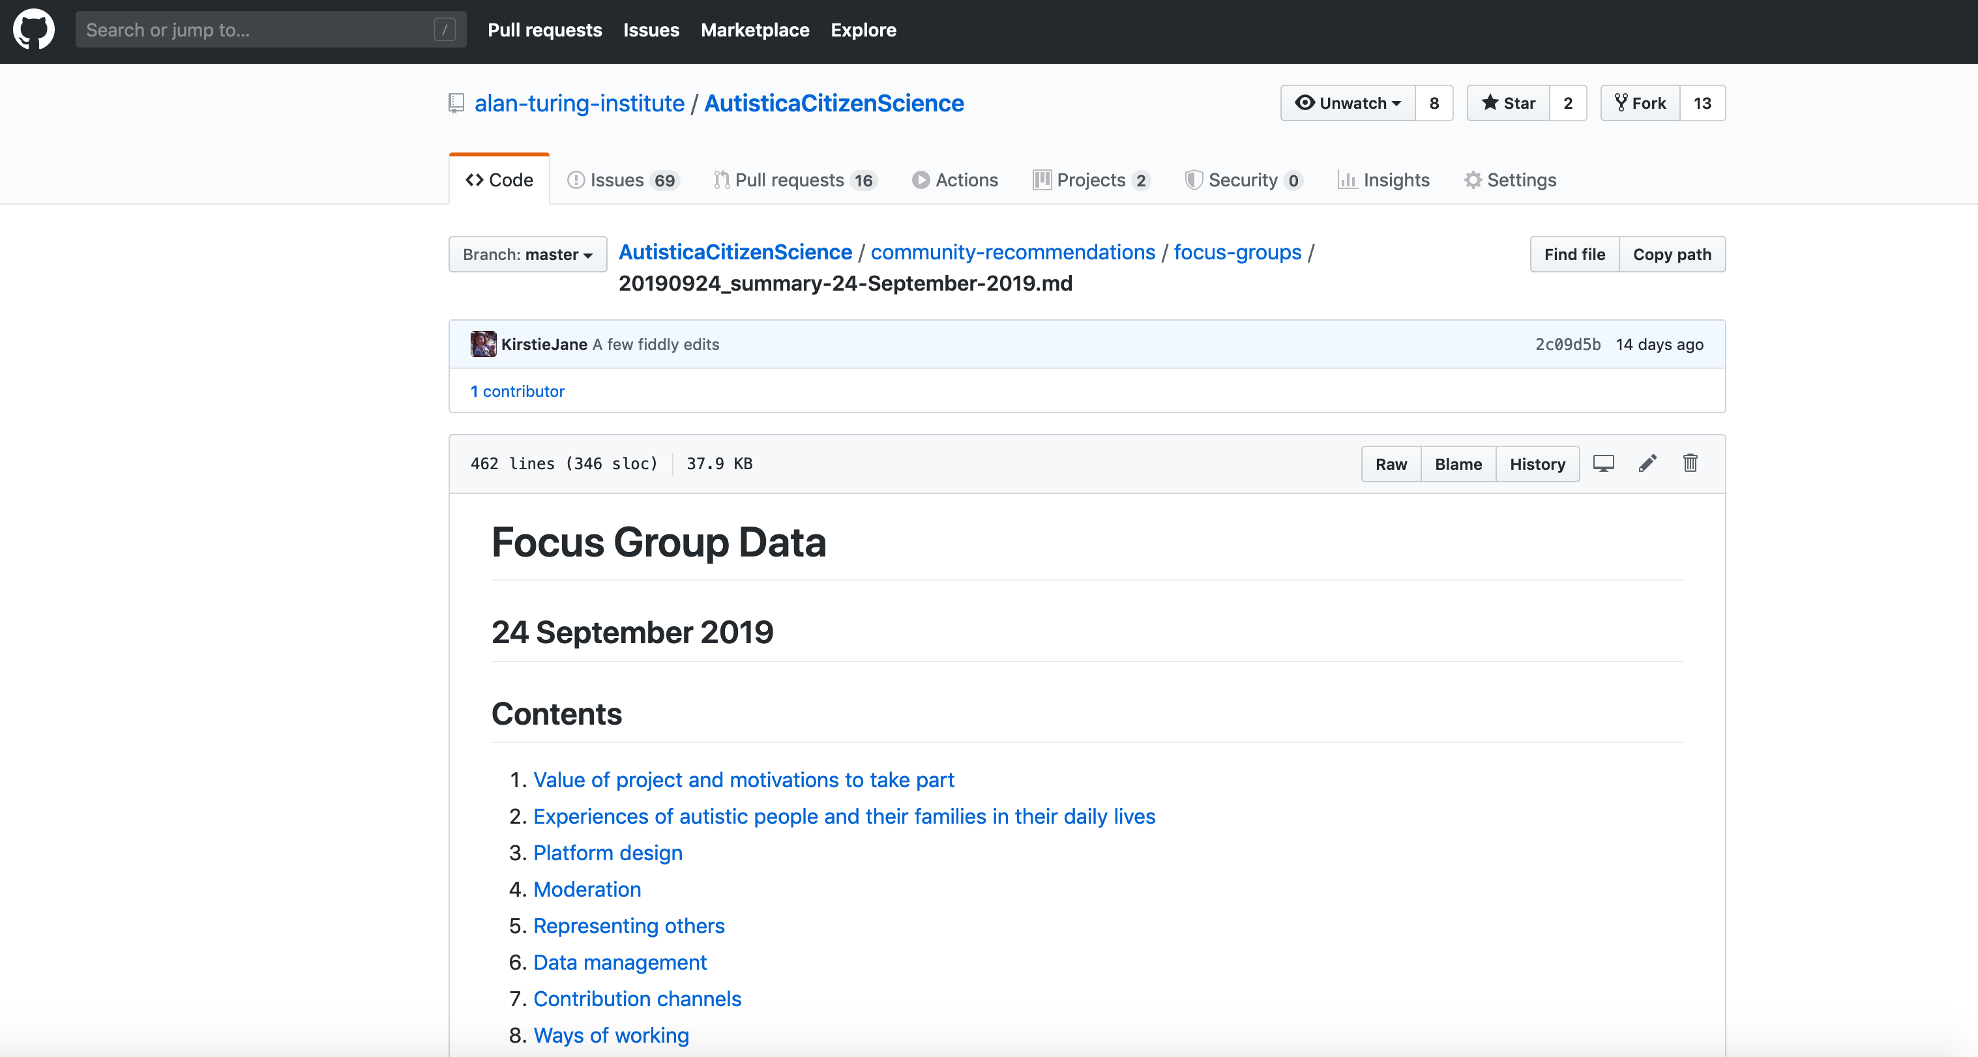
Focus group sessions
Transcripts
Summaries
Review
Publish
Notes:
https://github.com/alan-turing-institute/AutisticaCitizenScience/tree/master/community-recommendations- turning into a searchable database – NEXT STEPS – out both links on!
Use screenshot of website instead of repo
https://alan-turing-institute.github.io/AutisticaCitizenScience/community-recommendations/focus-groups/

Slide 11
Overview
Focus groups
Example insights
Translation to code
Future work: Moderation

Slide 12
(A d): “I’m autistic so I’ve got an awful lot of experience which I hope to contribute to the group”
Notes:
”Lived experience –experts by experience”
Katherine Manning – I wanted to show you this because: untapped experience – we have this concept of “lived experience”
https://github.com/alan-turing-institute/AutisticaCitizenScience/blob/master/community-recommendations/focus-groups/20190918_summary-18-September-2019.md#sharing-expertise-and-personal-perspective

Slide 13
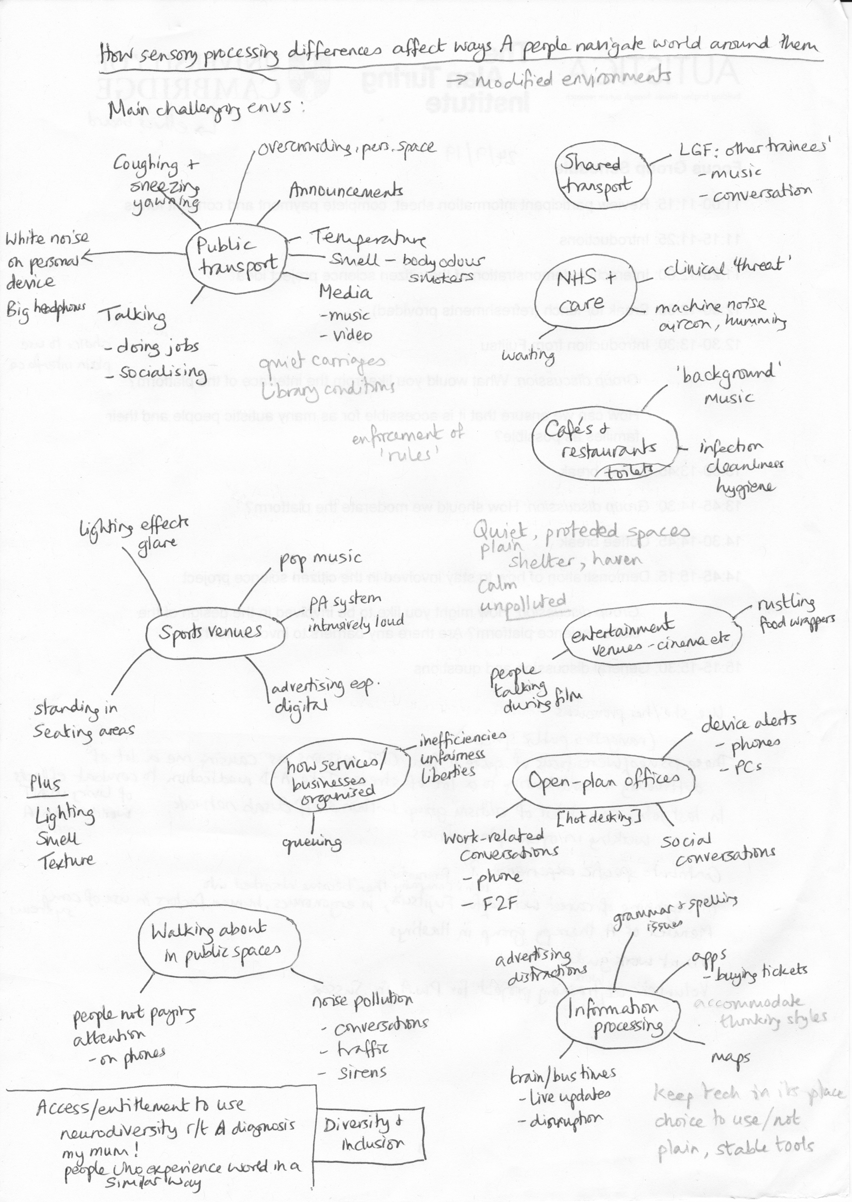
(A d): “I’m autistic so I’ve got an awful lot of experience which I hope to contribute to the group”
Notes:
”Lived experience –experts by experience”
Katherine Manning – I wanted to show you this because: untapped experience – we have this concept of “lived experience”
https://github.com/alan-turing-institute/AutisticaCitizenScience/blob/master/community-recommendations/focus-groups/20190918_summary-18-September-2019.md#sharing-expertise-and-personal-perspective

Slide 14
(A P d): as a parent and autistic person, “I’ve found a few things over the years” which have made life easier
Notes:
Diversity/
https://github.com/alan-turing-institute/AutisticaCitizenScience/blob/master/community-recommendations/focus-groups/20190918_summary-18-September-2019.md#creating-connectionscommunity

Slide 15

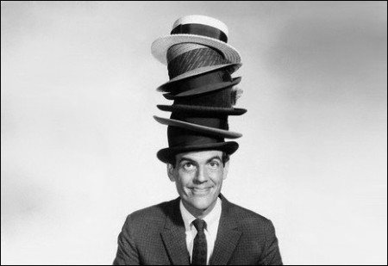
(A P d): as a parent and autistic person, I’ve found a few things over the years which have made life easier”
This Photo by Unknown Author is licensed under CC BY
This Photo by Unknown Author is licensed under CC BY-NC-ND
Notes:
Diversity/
https://github.com/alan-turing-institute/AutisticaCitizenScience/blob/master/community-recommendations/focus-groups/20190918_summary-18-September-2019.md#creating-connectionscommunity

Slide 16
(A g): “…there is an enormous lack of trust among autistic people when it comes to research…I think that needs to be very, very transparent, because there is that lack of trust”

Slide 17
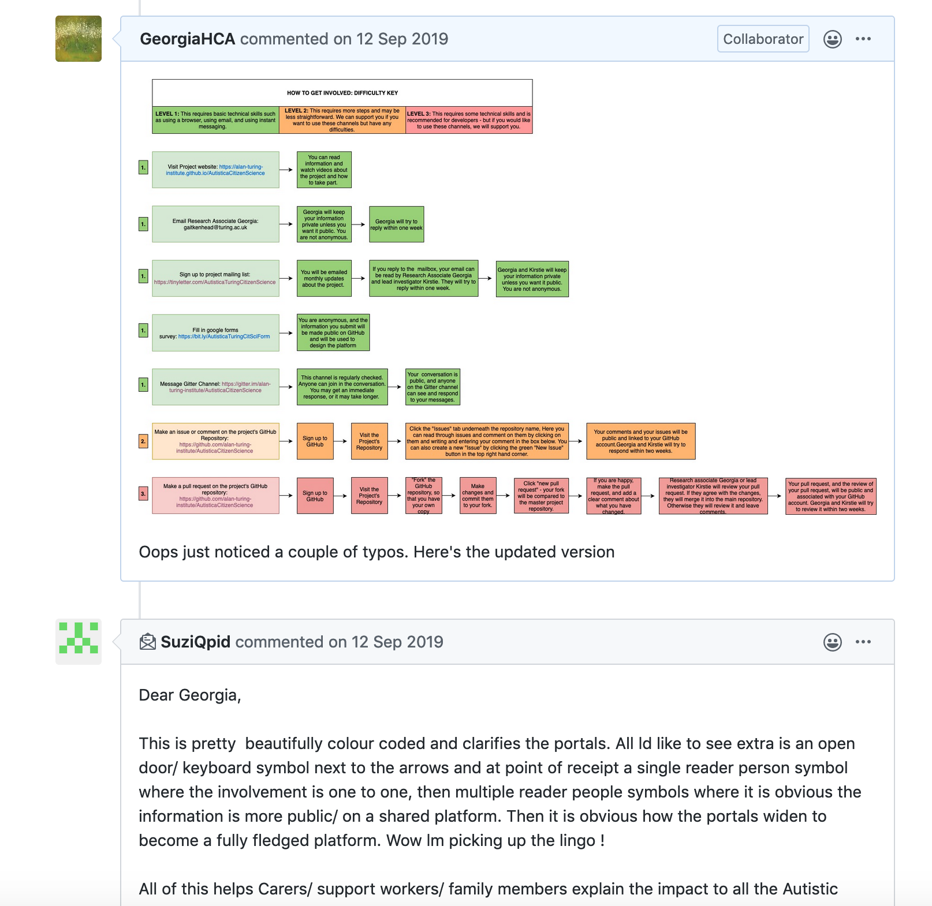
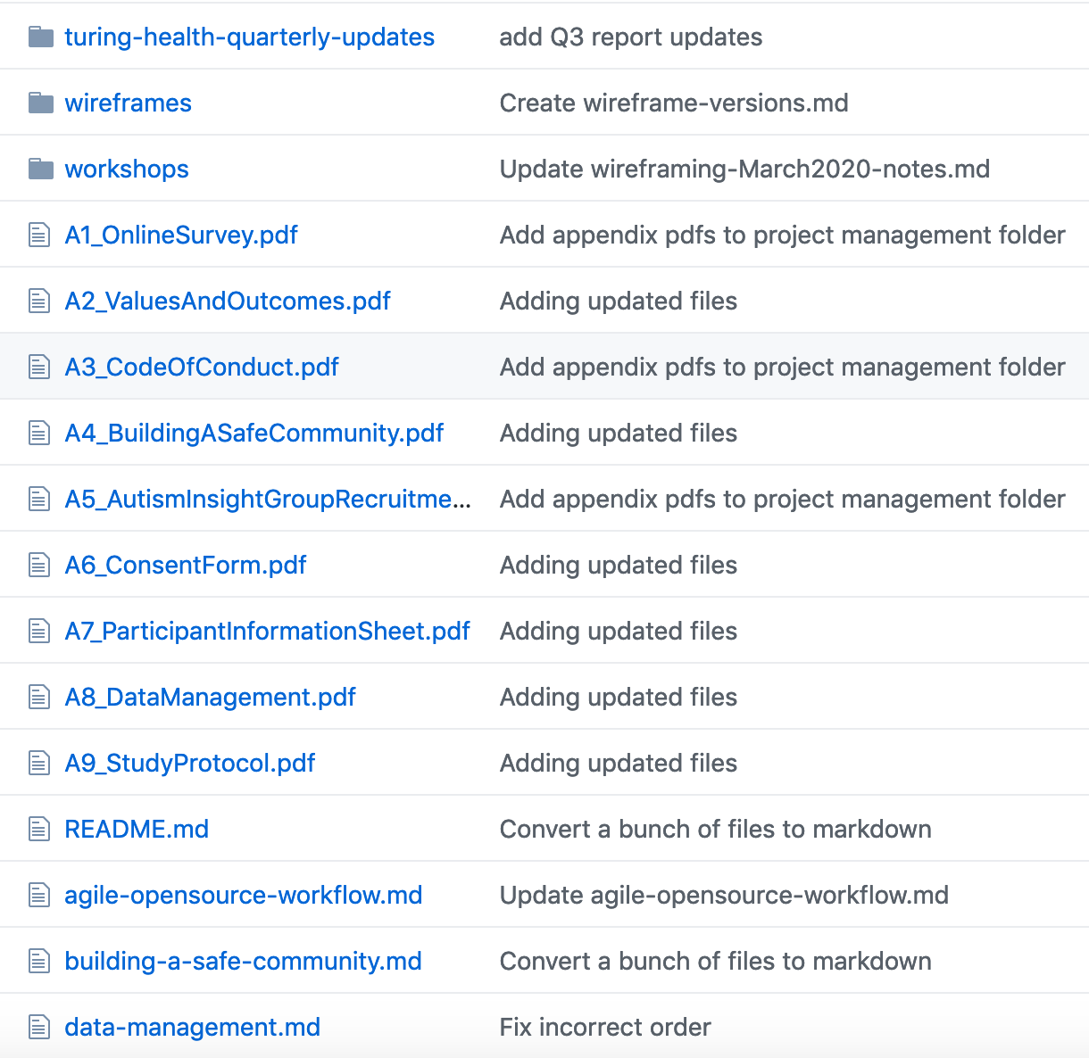

(A g): “…there is an enormous lack of trust among autistic people when it comes to research…I think that needs to be very, very transparent, because there is that lack of trust”
Notes:
https://github.com/alan-turing-institute/AutisticaCitizenScience/blob/master/community-recommendations/focus-groups/20190918_summary-18-September-2019.md#make-scope-of-research-clear
Making guidelines easier – documentation published and accessible, so available for. scruntiy – also regular newsletters showing progress

Slide 18
Overview
Focus groups
Example insights
Translation to code
Future work: Moderation

Slide 19
(P d): “unless we do include people who are non-verbal or not or minimally verbal, they’re going to continue to be a neglected group.”
(A d): “…having the option to…upload photos, or pictures, or voice recordings of people.”
Notes:
Representing others – guidelines –design etc.- how do we do this in a way which does not restrict the rights of autistic people to self-expression, but is highly inclusive?
https://github.com/alan-turing-institute/AutisticaCitizenScience/blob/GeorgiaHCA-Summary1/community-recommendations/focus-group-summaries-2019.md#b-non-verbal-means-of-inputting-information

Slide 20
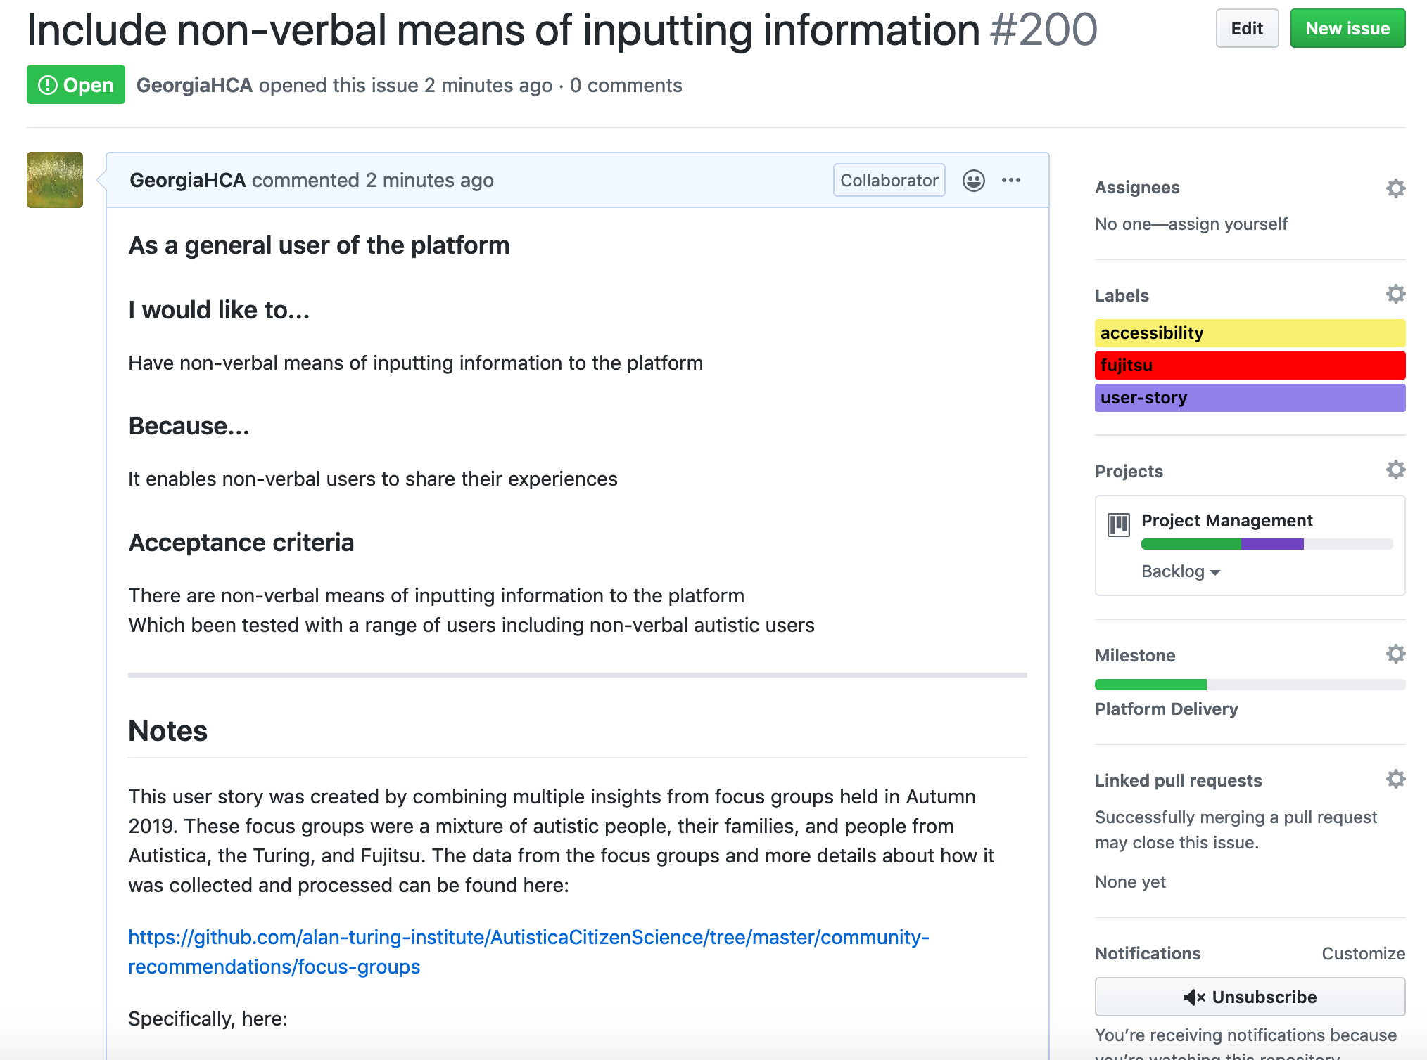

Slide 21
Overview
Focus groups
Example insights
Translation to code
Future work: moderation

Slide 22

What should we moderate for?
This Photo by Unknown Author is licensed under CC BY
Notes:
One of the next questions to be answered

Slide 23
What should we moderate for?
(P d): swearwords?
(A P d): “It’s a tough one”
(A P d): “I’m personally okay with it”
(P F i): depends on the age range of people logging on: “my 8 year-old nephew who’s autistic, he’s quite tech savvy so he’d be able to come on here and probably go onto the website, share his experiences, but I don’t think you really want an 8 year old reading swear words”
(A i): “…if you don’t include swear words, we end up quite restricting some people because that’s how they communicate”
(A d): have a setting to filter out swear words as a child-friendly option
(A P d): “f-ing and blind-ing all over the place… that’s completely by the by, I really couldn’t possibly care less”
(P d): discrimination and prejudice: sexist, racist, and homophobic and other comments”
Notes:
Lots of complexity
Making this public – not over-simplifying the narrative- getting a sense of the compromise, variety, complexity etc.

Slide 24





Thank you to the project team and you for listening
Kirstie Whitaker
Otis Smith
James Scott
Sarah Markham
James Cusack
Bethan Davies
Bastian Greshake Tzvoras
Andrew Harding
Craig Hall
Otis Smith
Tom Augur
All our focus group participants
Notes:
Thank you to the project team – especially our volunteers and focus group participants from the autistic community, and thank you to everyone from Autistica, The Alan Turing Institute, Open Humans and Fujitsu who are supporting the project.

Slide 25
Please join us
Anonymously, publicly share suggestions via the "always open" google form: https://bit.ly/AutisticaTuringCitSciForm
Say hello in our gitter channel: https://gitter.im/alan-turing-institute/AutisticaCitizenScience
Subscribe to our mailing list for monthly project updates: https://tinyletter.com/AutisticaTuringCitizenScience
Join the discussion in our issues and pull requests on GitHub: https://github.com/alan-turing-institute/ AutisticaCitizenScience
Notes:
Get involved – hand over now to Otis.
Otis has: given ideas, reviewed documents, protocols, pages, presentations (including this one), workshops, 1-2-1 meetings, he wanted to talk about what he has found from his involvement in the project.

